Slide 1
Monitoring and Analyzing Attacks
Project 3
Project Week 1
Project 3
Project Week
‹#›

Slide 3

For your third project,
you will use the skills you learned in the Defensive Security unit to design a custom monitoring environment to protect a fictional organization.
Notes:
shutterstock_1200423583

Slide 5
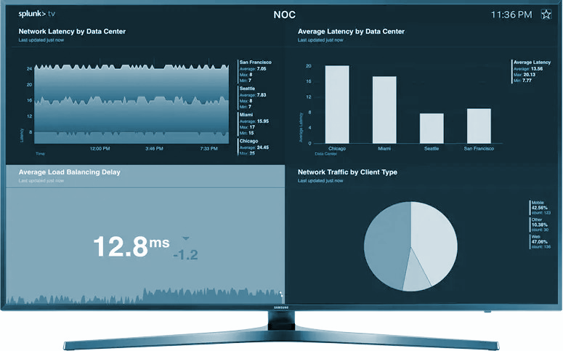
Day 1 Recap
Since VSI heard rumors that a competitor, JobeCorp, may launch cyberattacks to disrupt VSI’s business, you were tasked with using Splunk to develop a monitoring environment.
This environment can protect against potential attacks on VSI’s systems and applications.

Slide 6
In the last class, you developed a monitoring environment by:
1
Loading and analyzing Windows logs
2
Creating reports, alerts, and dashboards for the Windows logs
3
Loading and analyzing Apache logs
4
Creating reports, alerts, and dashboards for the Apache logs
5
Installing add-on Splunk applications for additional monitoring

Slide 7

Today’s Class
The rest of today’s class will proceed as follows:
1
Overview of daily tasks
2
Introduction to today’s project scenario
3
Preview of presentations for next class
4
Project work

Slide 8

Day 2 Overview

Slide 9




Day 2 Overview
You have just been notified by your manager that VSI recently experienced several cyberattacks, likely from its adversary JobeCorp. Unfortunately, this attack took down several of VSI’s systems.
Fortunately, you have just set up several monitoring solutions to help
VSI quickly identify what was attacked.
The attack targeted several systems — specifically, the Windows and Apache servers, which luckily you are monitoring.
Management has provided you with more logs from those servers. These new logs cover the time period during which the attack occurred.
Notes:
Attack: shutterstock_287479460

Slide 10
Day 2 Overview
You are now tasked with analyzing these “attack logs” with your monitoring solution to determine your solution’s efficacy.
Additionally, your findings will help VSI create any further mitigation strategies that are necessary.
Lastly, you will create a presentation that showcases your
monitoring solution and your findings to senior management.

Slide 11
Today’s Steps
Load Windows attack logs.
Analyze Windows attack logs.
Load Apache attack logs.
Analyze Apache attack logs.
Create project presentations.

Slide 12


Step 1
Load Windows Attack Logs
First, you will receive a set of “attack logs” from the Windows servers that run VSI’s back-end systems.
These logs were captured during the time when the attack occurred.
The activity guide will provide steps for loading and configuring these new logs.

Slide 13
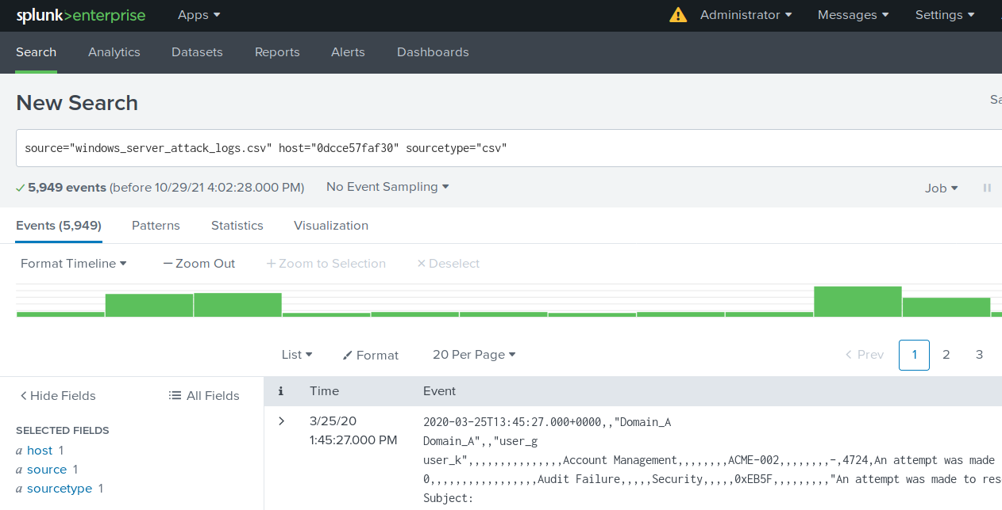
Step 2
Analyze Windows Attack Logs
Then, you will analyze the Windows attack logs to determine how effective your monitoring solution was or wasn't.

Slide 14
Step 3
Load Apache Attack Logs
You will also receive a set of “attack logs” from the Apache servers that run VSI’s back-end systems.
These logs were captured during the time when the attack occurred.
The activity guide will provide steps for loading and configuring these new logs.

Slide 15
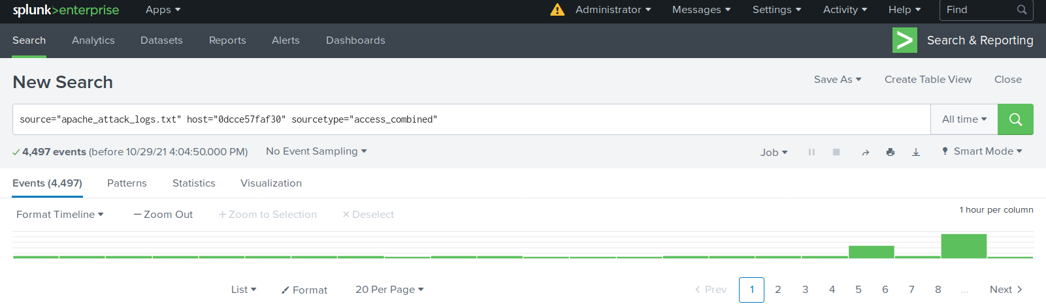
Step 4
Analyze Apache Attack Logs
Then you will analyze the Apache attack logs to determine how effective your monitoring solution was or wasn't.

Slide 16
Step 5
Start Creating Project Presentations
In today’s final step, you will begin preparing slides for a presentation of your work this week. You will present in groups on Day 3 of this project.
A framework for the slides and instructions will be provided to assist in the creation of the presentation.

Slide 17
You will present.

Slide 18
After you complete today’s activities, begin working on your presentations.

Slide 19
Project Day 3 Schedule:
First 30 Minutes:
Remaining 2 Hours:
You will work in groups to finalize your project presentations.
Groups will present their project presentations.

Slide 20
Day 2 Presentations
Each group will have 15 minutes for their presentation. Plan for a maximum of 12 minutes presenting, followed by 3 minutes of Q&A.
Groups can choose to have one presenter for the whole group, or have the group split up the presentation among members.
Work with your group to prepare the presentation, but every student must submit a complete presentation as a deliverable (even if it is the same as other group members’).
Use the framework provided for the presentation for general guidance, but feel free to enhance or adjust your presentation as your team sees fit.

Slide 21
Attacks Incoming!
In this project, you will analyze “attack logs” and determine how effective your monitoring solution was or wasn’t.
To end of class

Slide 22

Project Work Time

